Slide 1
Digital Logic Design and Application
Lecture #06

Slide 2
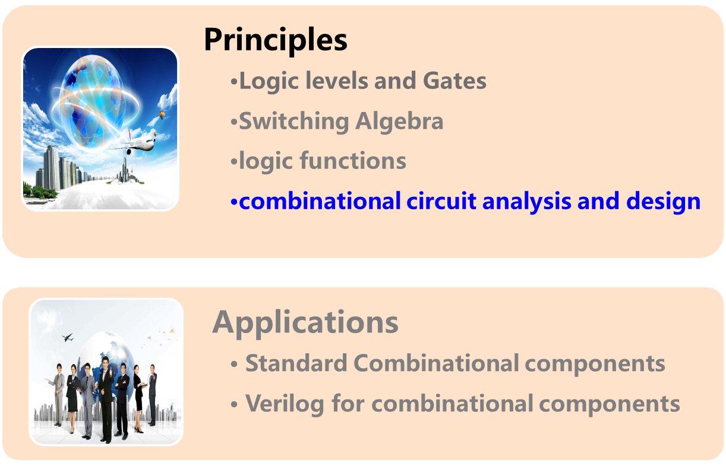
Topic 2-1 combinational circuits design

Slide 3

Combinational-Circuit Analysis
Chap. 3.1
Given a logic diagram for a combinational circuit, to obtain a formal description of its logic function.

Slide 4
Combinational-Circuit Analysis
Once we have the formal description of its logic function, a number of other operations are possible:
Determine the behavior of the circuit for various inputs.
Suggest a practical function of the circuit.
Suggest different circuit structures of the logic function and it’s standard digital circuits structures. For example, a sum-of-products expression corresponds to the NAND-NAND circuits.
To analysis a larger system that includes the circuit.

Slide 5
Combinational-Circuit Analysis
The most primitive functional description is the truth table.
Exhausting Way

Slide 6
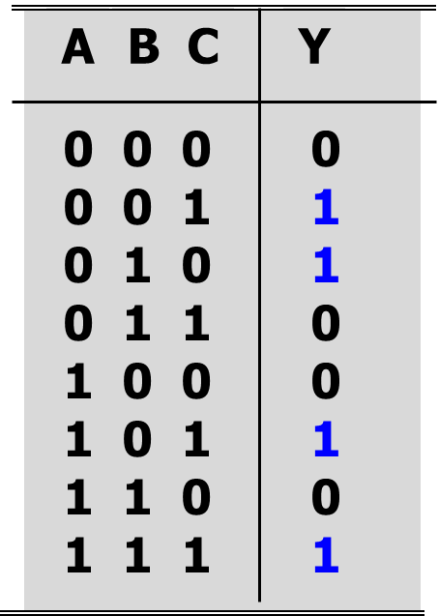
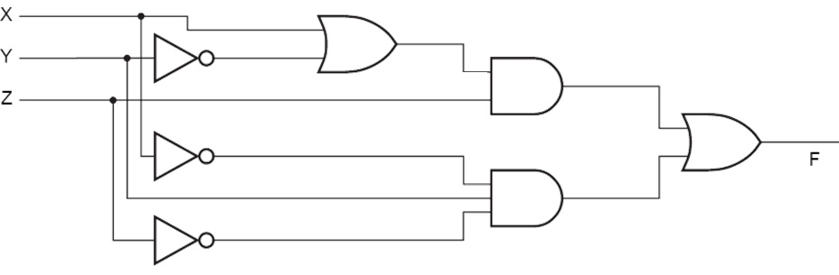


Combinational-Circuit Analysis
Exhausting Way
F =∑（1,2,5,7）

Slide 7
Combinational-Circuit Analysis
Logic expression
algebraic way
Z = F(A,B)=S’∙A+S∙B
Q1 ：can you suggest a practical function for this circuit?

Slide 8
Example 1: Analysis
3. Write truth table
A
B
C
Y
A
A’·B·C
0
0
0
0
&
0 0 0
0 0 1
0 1 0
0 1 1
1 0 0
1 0 1
1 1 0
1 1 1
1
1
1
1
1
A·B’·C
B
&
1
≥1
Y
&
C
A·B·C’
1
&
A’·B’·C’
1. Write expression for all gates
3. Suggest the practical function:
parity check
2. Write expression of output
Y = (A’·B·C + A·B’·C + A·B·C’ + A’·B’·C’)’
0 1 1
1 0 1
1 1 0
0 0 0

Slide 9
Example 2: Analysis
A
&
3. Write truth table
B
A
B
C
Y
B
&
&
Y
0 0 0
0 0 1
0 1 0
0 1 1
1 0 0
1 0 1
1 1 0
1 1 1
1
0
0
0
0
C
A
&
C
1. Write expression of output
1
Y = ( (A·B)’ · (B·C)’ · (A·C)’ )’
1
1
2. Simplify
Y = A·B + B·C + A·C
4. Suggest the practical function
Majority rule/ carry out for 1-bit FA

Slide 10
Combinational-Circuit Analysis
Approach:
  Start at the circuit inputs and propagate expression through gates toward the output.
  Simplify the logic expression
  (Fill in the truth table)
  Describe the logic function
  Start at the circuit inputs and propagate logic values (0s and 1s) through gates toward the output.
  Fill in the truth table
  Write and simplify the logic expression
  Describe the logic function
→Algebraic Way
→Exhausting Way

Slide 11


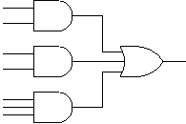
Combinational-Circuit Design
Chap. 3.2
Design（设计）: from informal description to digital circuit
Synthesis(综合): from formal description to logic diagram
    -Truth table
    -Expression
Synthesis
Minimization
Circuit Manipulations, obtain the logic circuit
Select devices
implementation
Yan Chen. UESTC

Slide 12
Example: Design a circuit to check the state of traffic lights.
Normal state
Abnormal state
1. logic abstraction:
Inputs: Red, Yellow, Green
correspond to the state of three lights
light→1, dark→0
Output: Fault
normal state→0, abnormal state→1
2. deduce logic relationship

Slide 13
Example: Design a circuit to check the state of traffic lights.
Normal state
Truth Table
R
Y
G
F
1 . logic abstraction :
Inputs: Red, Yellow, Green
correspond to the state of three lights
light→1, dark→0
Output: Fault
normal state→0, abnormal state→1
0 0 0
0 0 1
0 1 0
0 1 1
1 0 0
1 0 1
1 1 0
1 1 1
1
1
1
1
1
2. deduce logic relationship

Slide 14
3. Standard Logic Representation and minimization
AB
00 01 11 10
Truth Table
C
F =Σ_{A,B,C}(0,3,5,6,7)
0
1
0
1
0
R
Y
G
F
1
0
1
1
1
0 0 0
0 0 1
0 1 0
0 1 1
1 0 0
1 0 1
1 1 0
1 1 1
1
0
0
1
0
1
1
1
(( )’)’
= R’·Y’·G’ + R·Y + R·G + Y·G
= ((R’·Y’·G’)’ · (R·Y)’ · (R·G)’ · (Y·G)’)’
4. Circuit Manipulation
  4 AND gates & 1 OR gate
5 NAND gates
4
__ NOR gates

Slide 15
Combinational-Circuit Design
Approach:
  Logic abstraction
  Draw truth table
  Write logic functions
  Simplify the logic expression
  Circuit manipulations (design with NAND/ NOR gates)
  Circuit implementation

Slide 16
Combinational Logic Design Practices
Combinational circuits design
  based on truth table
  Small scale circuits
How to conceive a complex system?
  structured thinking
  Design based on the standard components
Yan Chen. UESTC
Notes:
Design of complex systems are often conducted in a structured way. First the system is decomposed into several small blocks and each of them performs a certain function and each of them is simple enough to be designed by truth table. Some of these functional blocks are used so frequently that people design them as standard component, such as decoders, encoders…. Designers can use these standard components directly in their designs. In structural design designers just need to specify the interconnections of these standard components and maybe do some other simple logic designs.

Slide 17
Some standard Combinational Components
Decoders
Encoders
Multiplexers
Parity Circuits
Comparators
Adders
ALUs
→XOR gates

Slide 18
Back ups
Yan Chen. UESTC

